Slide 1




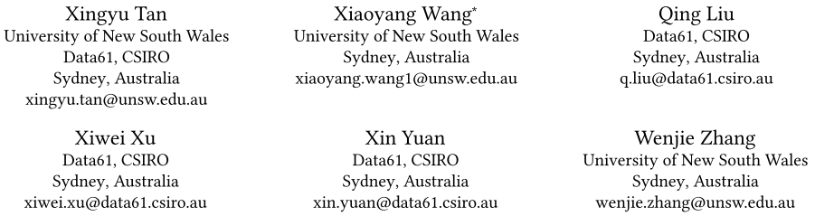





ATAI
Advanced Technique of Artificial Intelligence
ATAI
ChongqingUniversity _{AdvancedTechniqueof}
of Technology Artificial Intelligence
Chongqing University of
Technology
Chongqing University ^{ATAI}
_{of Technology} Advanced Techniqueof
Artificial Intelligence
Chongqing University of Technology
Chongqing University of Technology
Paths-over-Graph: Knowledge Graph Empowered Large
Language Model Reasoning
Code:https://github.com/SteveTANTAN/PoG
——WWW_2025
Reported by Long Zhang

Slide 2
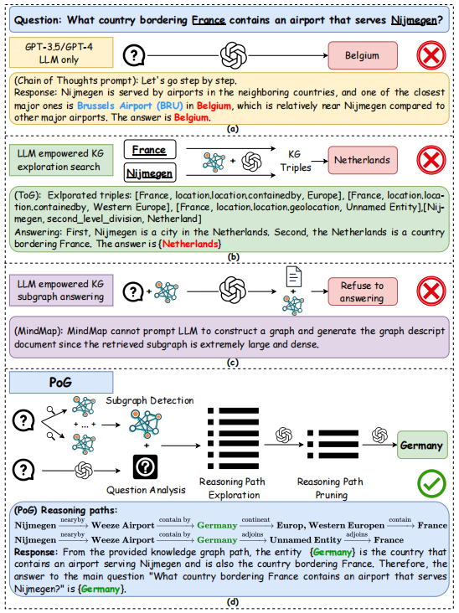
ATAI
Advanced Technique of Artificial Intelligence
ATAI
ChongqingUniversity _{AdvancedTechniqueof}
of Technology Artificial Intelligence
Chongqing University of
Technology
Chongqing University ^{ATAI}
_{of Technology} Advanced Techniqueof
Artificial Intelligence
Chongqing University of Technology
Chongqing University of Technology
Motivation
1) Multi-hop reasoning problem. Focusing on one-hop neighbors can result in plausible but incorrect answers and prematurely exclude correct ones.
2) Multi-entity question. Existing work typically explores KG for each topic entity independently.
3) Utilizing graph structure. Existing methods often overlook the inherent graph structures when processing retrieved subgraphs.

Slide 3
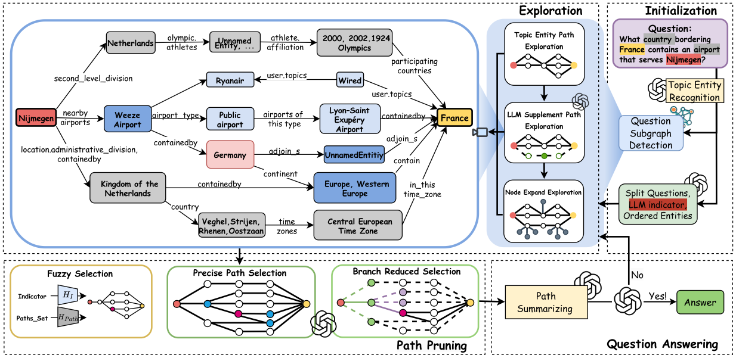
ATAI
Advanced Technique of Artificial Intelligence
ATAI
ChongqingUniversity _{AdvancedTechniqueof}
of Technology Artificial Intelligence
Chongqing University of
Technology
Chongqing University ^{ATAI}
_{of Technology} Advanced Techniqueof
Artificial Intelligence
Chongqing University of Technology
Chongqing University of Technology
Method

Slide 4
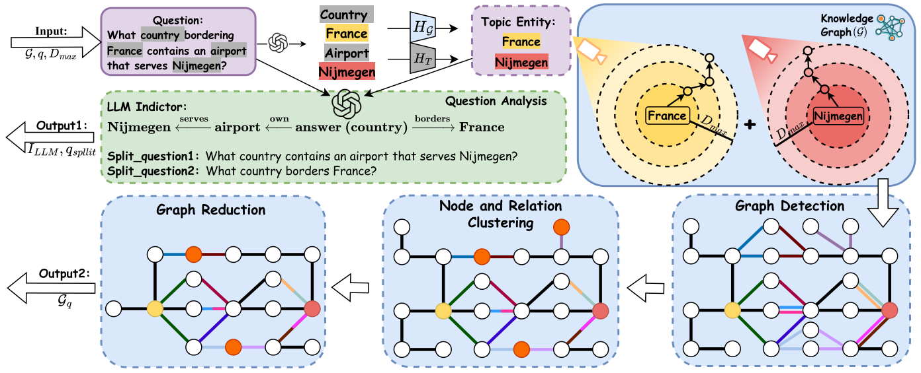
ATAI
Advanced Technique of Artificial Intelligence
ATAI
ChongqingUniversity _{AdvancedTechniqueof}
of Technology Artificial Intelligence
Chongqing University of
Technology
Chongqing University ^{ATAI}
_{of Technology} Advanced Techniqueof
Artificial Intelligence
Chongqing University of Technology
Chongqing University of Technology
Method

Slide 5











ATAI
Advanced Technique of Artificial Intelligence
ATAI
ChongqingUniversity _{AdvancedTechniqueof}
of Technology Artificial Intelligence
Chongqing University of
Technology
Chongqing University ^{ATAI}
_{of Technology} Advanced Techniqueof
Artificial Intelligence
Chongqing University of Technology
Chongqing University of Technology
Method
as the sets of short textual descriptions for each entity 𝑒∈ E and each relation 𝑟∈ R

Slide 6
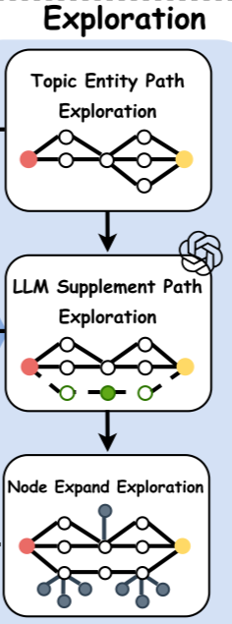



ATAI
Advanced Technique of Artificial Intelligence
ATAI
ChongqingUniversity _{AdvancedTechniqueof}
of Technology Artificial Intelligence
Chongqing University of
Technology
Chongqing University ^{ATAI}
_{of Technology} Advanced Techniqueof
Artificial Intelligence
Chongqing University of Technology
Chongqing University of Technology
Method

Slide 7
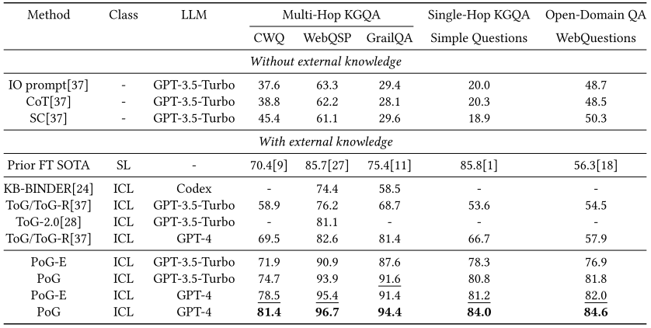
ATAI
Advanced Technique of Artificial Intelligence
ATAI
ChongqingUniversity _{AdvancedTechniqueof}
of Technology Artificial Intelligence
Chongqing University of
Technology
Chongqing University ^{ATAI}
_{of Technology} Advanced Techniqueof
Artificial Intelligence
Chongqing University of Technology
Chongqing University of Technology
Experiments

Slide 8
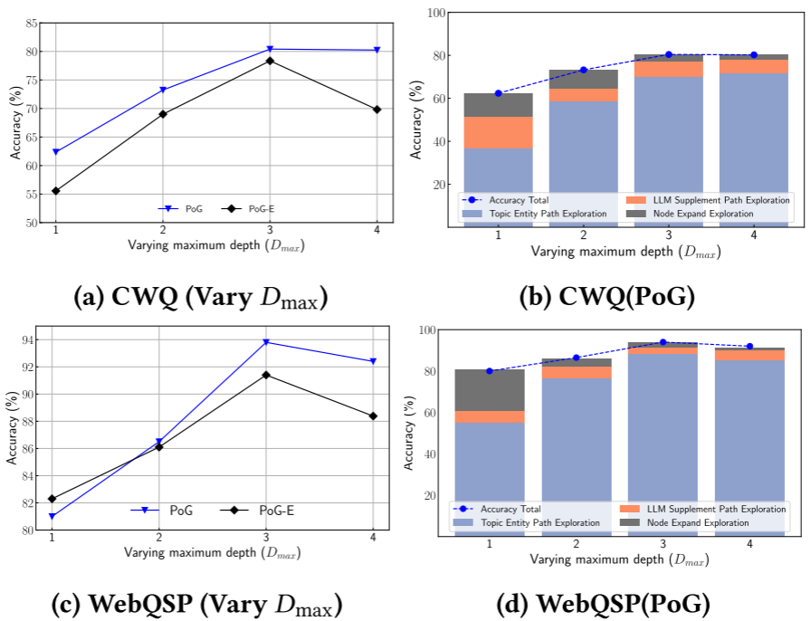
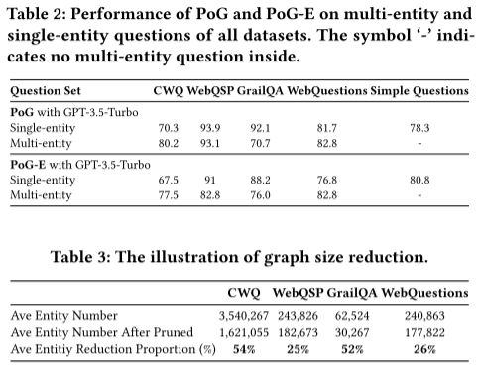
ATAI
Advanced Technique of Artificial Intelligence
ATAI
ChongqingUniversity _{AdvancedTechniqueof}
of Technology Artificial Intelligence
Chongqing University of
Technology
Chongqing University ^{ATAI}
_{of Technology} Advanced Techniqueof
Artificial Intelligence
Chongqing University of Technology
Chongqing University of Technology
Experiments

Slide 9

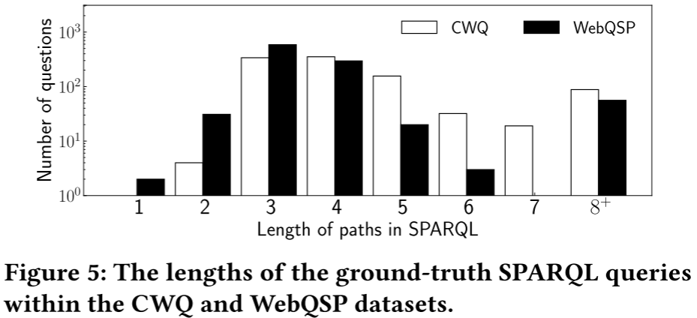
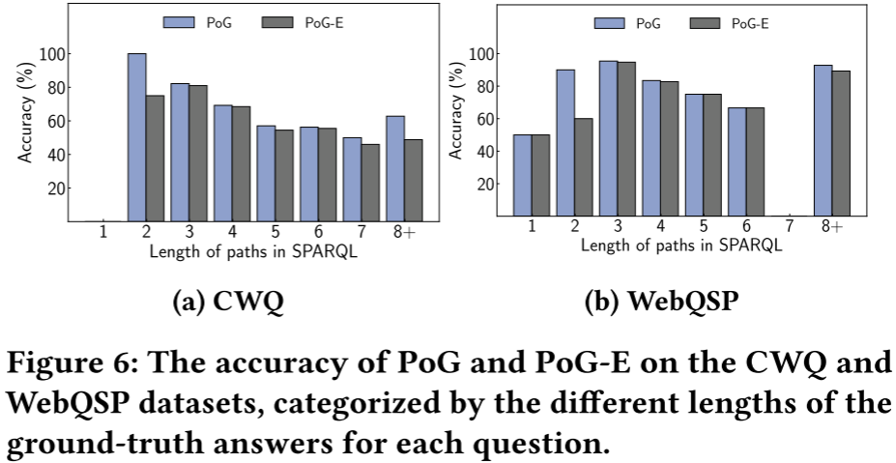
ATAI
Advanced Technique of Artificial Intelligence
ATAI
ChongqingUniversity _{AdvancedTechniqueof}
of Technology Artificial Intelligence
Chongqing University of
Technology
Chongqing University ^{ATAI}
_{of Technology} Advanced Techniqueof
Artificial Intelligence
Chongqing University of Technology
Chongqing University of Technology

Slide 10


ATAI
Advanced Technique of Artificial Intelligence
ATAI
ChongqingUniversity _{AdvancedTechniqueof}
of Technology Artificial Intelligence
Chongqing University of
Technology
Chongqing University ^{ATAI}
_{of Technology} Advanced Techniqueof
Artificial Intelligence
Chongqing University of Technology
Chongqing University of Technology
Thanks!

